Slide 1
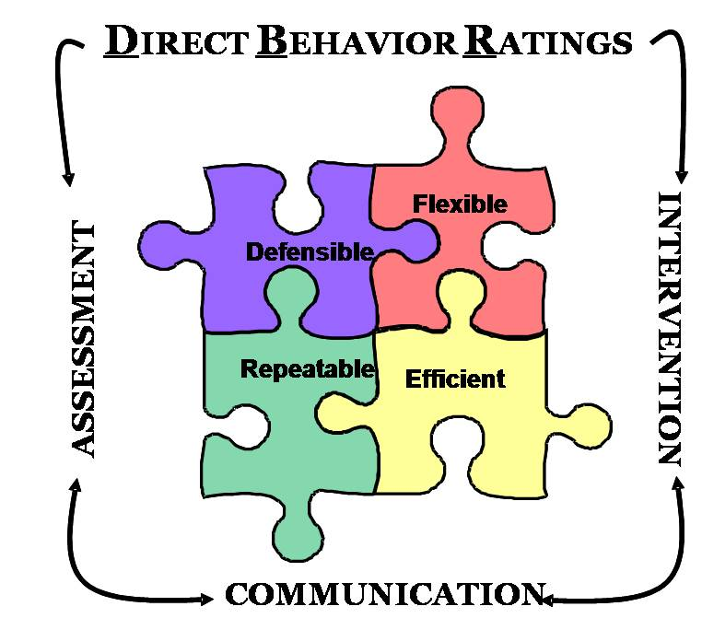
Direct Behavior Rating (DBR): Overview and Possible Applications within Tier I
Sandra M. Chafouleas, Ph.D.
Center for Behavioral Educational and Research
University of Connecticut
CITATION: Iovannone, R., Chafouleas, S.M., & Lynass, L. (2010). Direct Behavior Rating (DBR): Tools for Progress Monitoring within Multi-tiered Behavioral Support (Part I: Direct Behavior Rating (DBR): Overview and Possible Applications within Tier I). Paper presentation at the 7th International Conference on Positive Behavior Supports, St. Louis, MO.

Slide 2
My Purpose:
To introduce Direct Behavior Rating (DBR) as an assessment method for progress monitoring of student behavior
To review options for use of DBR in Tier I assessment purposes

Slide 3
Overview of DBR in Assessment: History & Defining Features

Slide 4
BRIEF REVIEW: Why do we need data?
Purposes of Assessment
Screening
Progress Monitoring
Diagnosis
Evaluation
Emphasized within a problem-solving framework
Notes:
When data are needed to identify those students who are either academically or socially at-risk, assessment tools are used for screening purposes. Screening assessments can be conducted for a subset of students or the entire population (UNIVERSAL SCREENING)
Progress monitoring is conducted with tools that allow for ongoing, repeated evaluation over time.
Diagnostic assessment provides in depth information about student skills and needs.
The goal of evaluation is to provide a global, summative picture of behavior.

Slide 5
What is “problem-solving framework”?
Two Basic Questions:
How do we know X is a “problem”?
How do we know if Y is an effective strategy for “handling” X?
(Bergan, 1977, Bergan &Kratochwill, 1990; Tilly, 2009; Reschly& Bergstrom, 2009)
What is the problem?
Why is it occurring?
What should we do about it?
Did it work?

Slide 6
What are desirable features of assessment tools within PSM?
Defensible
established through psychometric research to provide evidence of reliability and validity for interpretation and use
Flexible
established by methods useful in guiding a variety of assessment questions and situations
Efficient
established by methods that require relatively few resources (feasible and reasonable)
Repeatable
established by methods that yield necessary time series to evaluate intervention effectiveness
Source: Chafouleas, Riley-Tillman, & Christ, 2009; Chafouleas, Riley-Tillman, & Sugai, 2007; Christ, Riley-Tillman, & Chafouleas, 2009)
Measurement Concerns
Psychometric Properties
Measurement
Targets
Feasibility Concerns
Obtrusiveness
Staff Resources
Time
Type of Assessment
Adapted from Briesch & Volpe (2007)

Slide 7
BUT for behavior, it’s not so simple…
Possible Methods:
Systematic direct observation
Traditional behavior rating scales
Permanent products (ODR)
Direct Behavior Rating

Slide 8
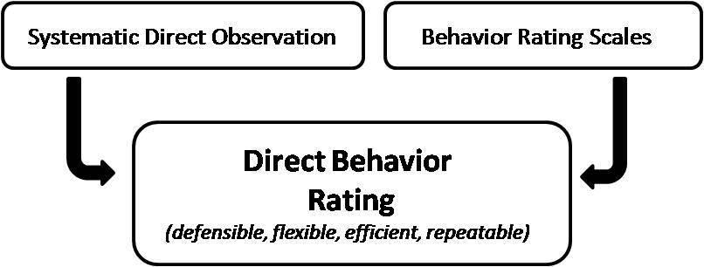
DIRECT BEHAVIOR RATING : What is DBR?
An emerging alternative to systematic direct observation and behavior rating scales which involves brief rating of target behavior following a specified observation period
Chafouleas, Riley-Tillman, & Christ (2009); Chafouleas, Riley-Tillman, & Sugai (2007); Chafouleas, Riley-Tillman, & McDougal (2002); Christ, Riley-Tillman, & Chafouleas (2009)

Slide 9
A little background…
Other Names for DBR-like Tools:
Home-School Note
Behavior Report Card
Daily Progress Report
Good Behavior Note
Check-In Check-Out Card
Performance-based behavioral recording
Contemporary Defining Features:
SDO
BRS
Used repeatedly to represent behavior that occurs over a specified period of time (e.g., 4 weeks) and under specific and similar conditions (e.g., 45 min. morning seat work)

Slide 10
Direct Behavior Rating
Direct
establishes that the observation and rating occur at the time and place that behavior occurs.
This minimizes
inference &
retrospective judgments
Notes:
Rationale:
Greater inference associated with retrospective judgments of behavior that are collected at a time and place where behavior did not occur.
Therefore, a behavior rating is a direct behavior rating if data are generated in close proximity to the time and place that the behavior occurs.

Slide 11
Direct Behavior Rating
Behavior
the target of assessment must be accessible for observation and evaluation by the intended rater.
the preference is to observe behavior within the naturalistic setting.
contents/modalities for behavioral assessment are motor, physiological, and cognitive (Cone, 1978).
Notes:
Accessible for observation
Naturalistic
Motor, Physiological & cognitive (these are all behaviors)

Slide 12
Direct Behavior Rating
Rating
quantify a person’s perception or attitude toward something.
DBR can be compared to any of a variety of other problem solving and behavioral assessments
SDO
Interviews
behavioral rating scales
Notes:
Perception – measure of perception of behavior

Slide 13
Direct Behavior Rating & Other Methods
Source: Christ, Riley-Tillman, & Chafouleas (2009)

Slide 14
Example Scale Formats for
DBR
Source: Chafouleas, Riley-Tillman, & Christ (2009)

Slide 15
Project VIABLE: Validation of Instruments for Assessing Behavior Longitudinally &Efficiently
GOAL: Develop and Evaluate DBR
Phases I & II: Develop instrumentation and procedures; evaluate defensibility of DBR in decision-making
Large datasets; repeated observations of student behavior
Understanding critical factors (e.g. scale format, behavior targets, training requirements)
Pilot testing various aspects with classroom teachers
Phase III: Evaluate feasibility and utility of DBR in school settings.
Packaging what we have learned to
then train teachers
Establish groups of teachers/schools willing
to participate in DBR training and use
Evaluate data/feedback
Sandra M. Chafouleas
T. Chris Riley-Tillman
Theodore J. Christ
George Sugai
Funding provided by the Institute for Education Sciences, U.S. Department of Education (R324B060014).

Slide 16
DBR – Single Item Scale
Ratings should correspond to the percentage of time that the student was observed to display the target behavior.
Ex: When rating after 40-minute Independent Reading Block, if the student was engaged for 20 minutes, then the student receives a rating of 5 on the DBR.
Academically Engaged
Never
Always
40 minutes
Notes:
Now that you understand which behaviors you will be rating, there are a few important procedures involved in using a DBR scale to rate those behaviors.
First, as our previous example illustrated, you will use the scale gradients that range from 0-10 to indicate the proportion of time that the student was observed to display the target behavior. Using this DBR scale, you are not rating the severity of the target behavior or number of times the behavior occurred, but rather, an estimate of the percentage of total time spent displaying the behavior.
In this example, during 40-minute Independent Reading Block, Mr. Jones observed Suzie to be reading for 10 minutes, staring out the window for 20 minutes, and then reading again for the last 10 minutes. Thus, Suzie received a rating of 5 on the DBR because she was engaged for a total of 20 minutes, or 50% of the time.

Slide 17
Key Pieces to using DBR-SIS:
Have the rating ready (date, name). Complete rating immediately following the activity period.
Skip rating if you did not observe for a sufficient amount of time.
Ratings should correspond to the proportion of time that you actually observed the student display the target behavior.
When rating, each behavior should be considered independently of the other targets. That is, total ratings across behaviors do not have to equal 100%.
For example, a student may be engaged 50% of the time, and disruptive 20%. A student may also be engaged for 100% of the time, and disruptive for 10%.

Slide 18
Which targets do I rate using DBR-SIS?
Academic Engagement:
Actively or passively participating in the classroom activity.
Academically Engaged
Non-Disruptive
Respectful
Respectful:
Compliant and polite behavior in response to adult direction and/or interactions with peers and adults.
KEYS TO
SUCCESS
Disruptive Behavior:
A student action that interrupts regular school or classroom activity.

Slide 19
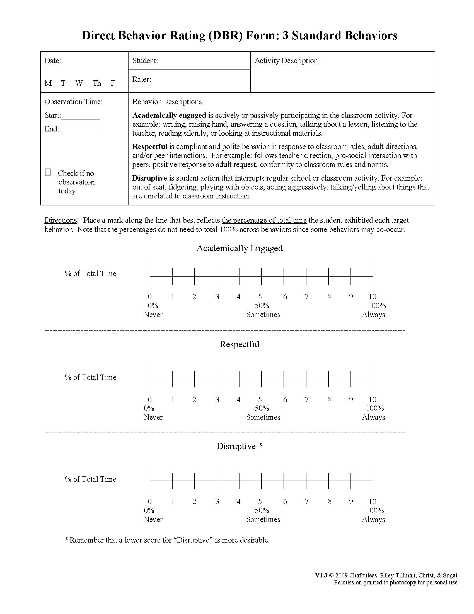
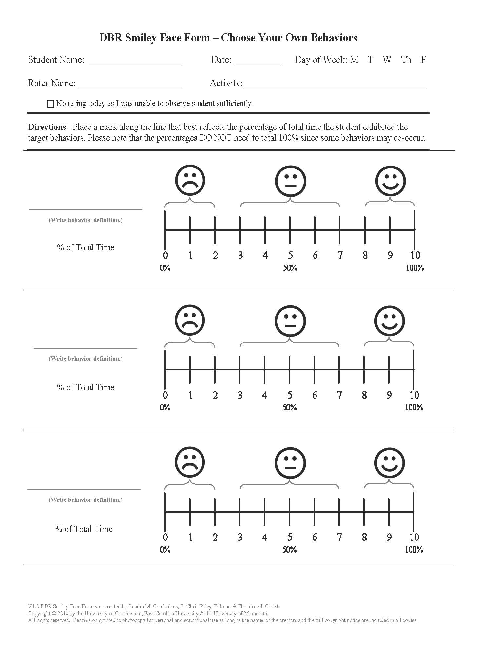
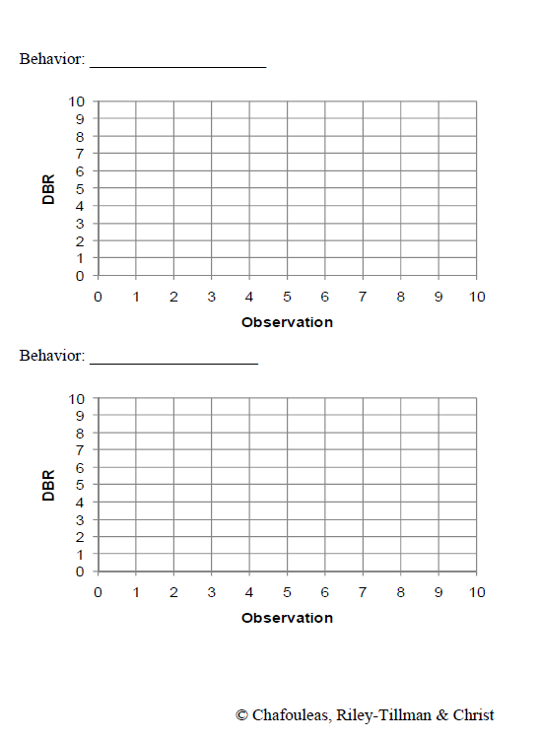
Current Forms: www.directbehaviorratings.com

Slide 20
Application of DBR-SIS in Tier I: Examples and Considerations

Slide 21
Possibilities…
Progress Monitoring Assessment of a “group”
Small group, classwide
Universal Screening Assessment for Early Identification of Risk
Individual focus

Slide 22
Case Study Example: Classwide Assessment
Riley-Tillman, Methe, & Weegar (2009)
Sample: First grade classroom with 14 students
Design: B-A-B-A
Intervention: modeling and prompting of silent reading
Measures: researcher-completed SDO, teacher-completed DBR-SIS
Conclusion: DBR data can be sensitive to classroom-level intervention effects, maps closely to resource-intensive SDO
 | Phase Mean
 | B1 | A1 | B2 | A2
DBR | 72 | 45 | 63 | 42
SDO | 68 | 49 | 61 | 50

Slide 23
Example: Early Identification and Monitoring using “Local” Norms
Chafouleas, Kilgus, & Hernandez (2009)
Sample: full day K inclusive classroom, 2 teachers and 22 students
Measures: teacher-completed DBR-SIS following am and pm over Nov-March for ALL students
Conclusion: “Local” cut-score comparisons can be useful in examining individual student performance. Periodic re-assessment of all may be needed to re-confirm appropriate comparison
Target Behavior | Rating Time | FALL M (SD) | SPRING M (SD)
Academic Engagement | AM | 8.72 (1.31) | 9.40 (0.63)
 | PM | 8.25 (2.03) | 9.37 (0.88)
Disruptive Behavior | AM | 1.30 (1.47) | 0.60 (0.62)
 | PM | 1.61 (2.08) | 0.42 (0.52)

Slide 24
Example: Early Identification using “Cut-Points”
 |  | Condition (est. via the “gold standard”)
 |  | Positive | Negative
Test Outcome | Positive | TRUE Pos. | FALSE Pos. (Type I error) | = Pos. predictive value
 | Negative | FALSE Neg. (Type II error) | TRUE Neg. | = Neg. predictive value
 |  | = Sensitivity | = Specificity
Example DBR-SIS with BESS Criterion
Target Behavior | Cut Score | SS | SP | PPP | NPP
Disruptive Behavior | 1.210 1.530 1.580 1.845 | .917 .875 .833 .792 | .615 .698 .698 .771 | .373 .420 .408 .463 | .967 .957 .944 .937
Academic Engagement | 7.165 7.365 7.895 8.055 8.410 | .792 .833 .875 .917 .958 | .844 .823 .771 .719 .677 | .559 .541 .488 .449 .426 | .942 .952 .961 .972 .985
Kilgus, Chafouleas, Riley-Tillman, & Welsh (in prep)
Purpose: To evaluate the diagnostic accuracy of all possible DBR-SIS (Disruptive Behavior, Academic Engagement, Compliance)
Sample: Second grade teachers and randomly selected students in their classrooms
Measures: teacher-completed DBR-SIS following am and pm over 1 week, BESS and SSiS Performance Screener
Analyses: Diagnostic accuracy statistics
Conclusion: DBR may provide efficient initial identification of potential risk, but may need to be confirmed through complementary measures. Findings suggest interpretation of DBR-SIS “cut-score” may be highly dependent on what is considered to be a “true” indicator of school-based behavioral difficulty.

Slide 25
Questions & Comments…
Contact: Dr. Sandra Chafouleas sandra.chafouleas@uconn.edu
www.directbehaviorratings.com
www.cber.org

